Slide 1

Order Management System
PLP Project By – Agraj Naman Mishra

Slide 2
Contents
Introduction
Scopes
UML Diagram
Flow and ER Diagram
Walkthrough Screenshots
Validation and Assumption
Result and Summary

Slide 3
Introduction
Order Management System is an application which automates all the hassle of creating order invoices and Individual product invoices at sales level of a company. It’s deployed over salesforce.com. The accessibility to the application is divided over 3 types of company associates named: Support User, Business User and Sales User.

Slide 4
Scopes
InScopes :
Sales User : Characteristics --- >
This is the only class of user that can create the Orders but cannot delete them.
They can view their order records.
They can create contract but cannot delete them.
They can create Accounts but cannot delete them.
Each Sales User is managed by a Business User.
Can view the Auto-generated Invoice and Auto-generated Product Invoice

Slide 5
Business User : Characteristics --- >
This class can only view : Orders, Contract , Account , Invoice , Product Invoice of its managed sales user only.
They are the approver of the approval process called from there managed sales user profile.

Slide 6
Support User : Characteristics --- >
They are more like Administrator of the entire application. They have read and write permission over all the standard and custom objects.
They monitor the entire statistics through reports and dashboard.

Slide 7
Out Scopes :
Following functionalities are not covered in the application :
Application cannot track beyond the ‘ Invoice Generated ’ order stage.
Application cannot track delivery info.
Payment are not accepted by application.

Slide 8
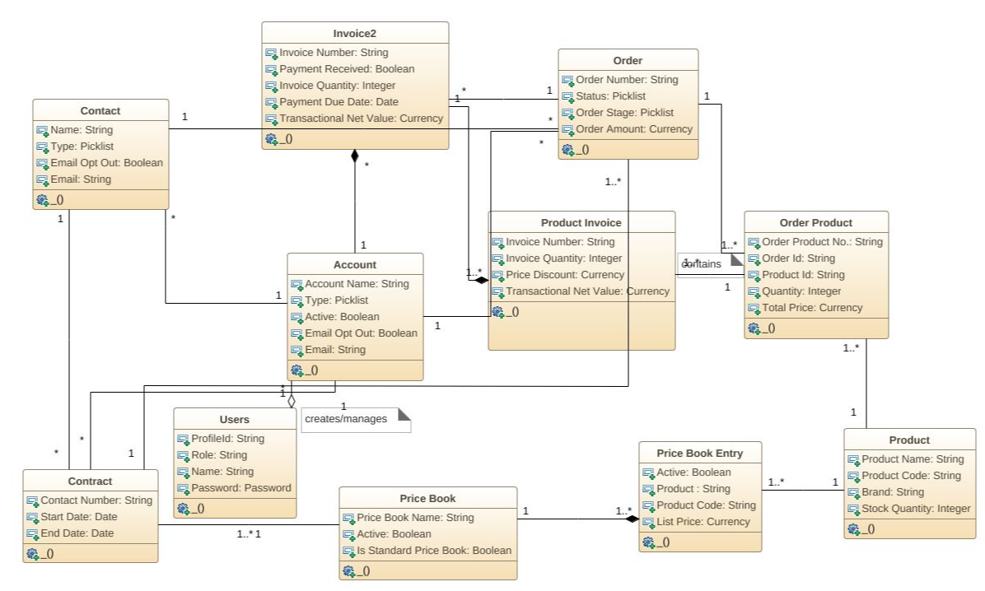
UML Diagrams – Class Diagram

Slide 9
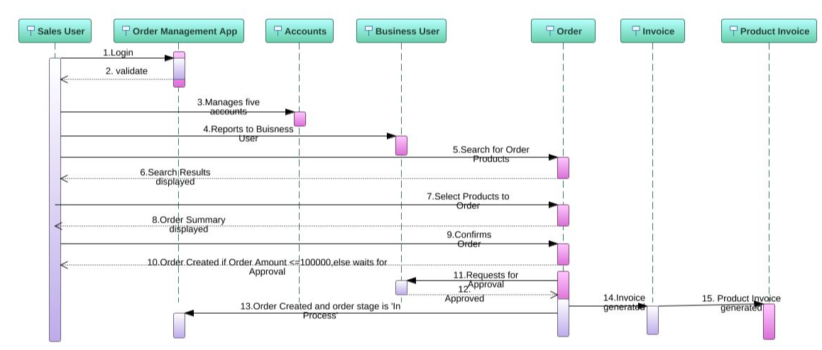
UML Diagrams – Sequence Diagram

Slide 10
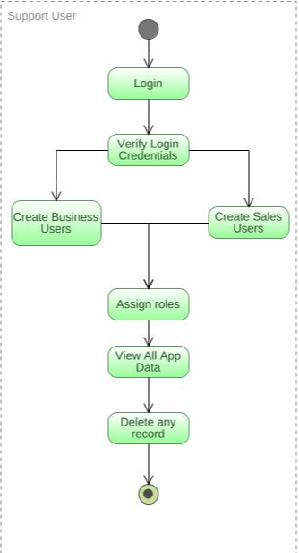
UML Diagram – Activity Diagram (Support User)

Slide 11
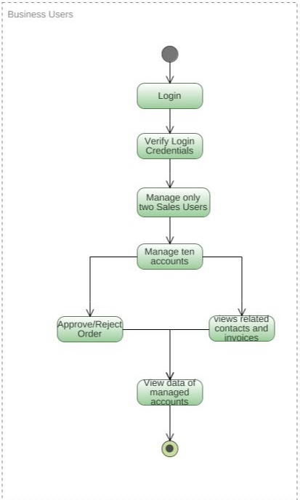
UML Diagram – Activity Diagram (Bussiness User)

Slide 12
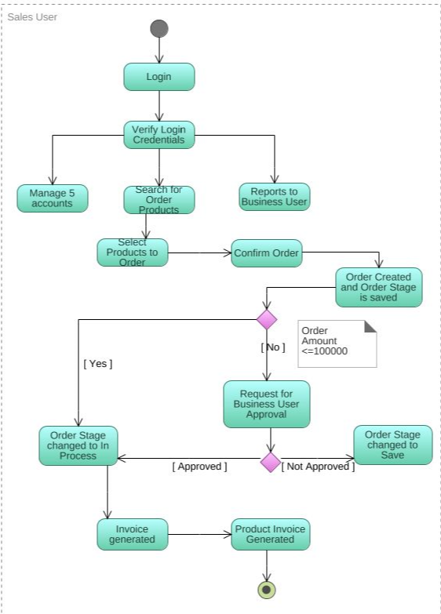
UML Diagram – Activity Diagram (Sales User)

Slide 13
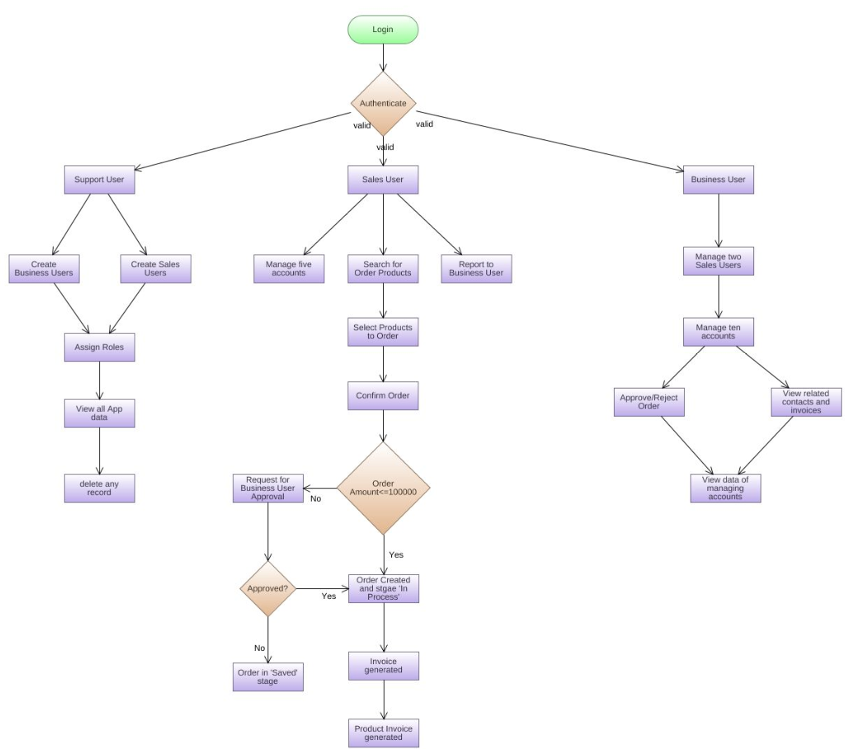
Flow Chart

Slide 14
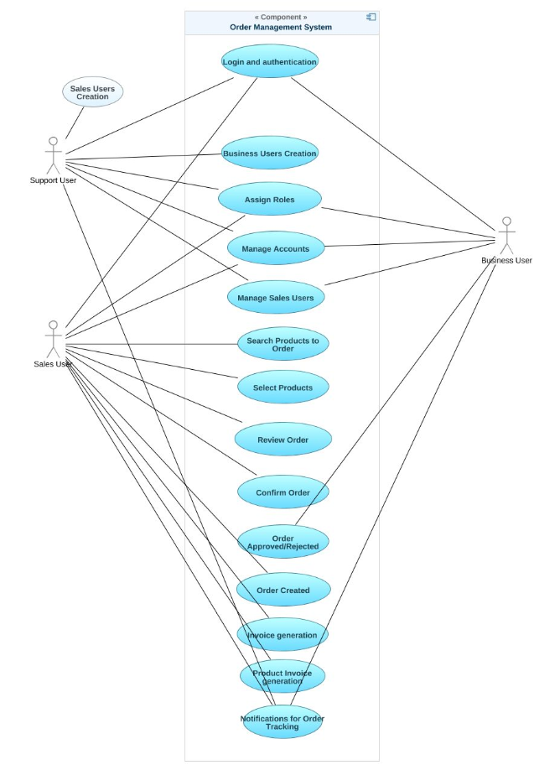
Usecase Diagram

Slide 15
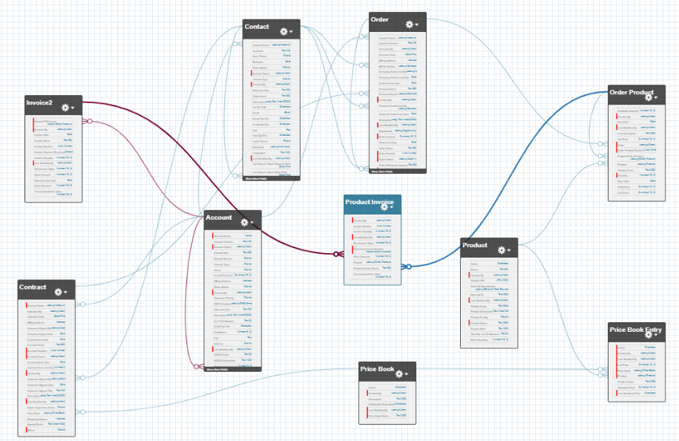
ER-Diagram

Slide 16
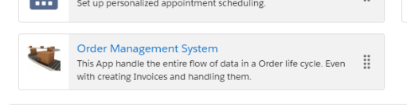
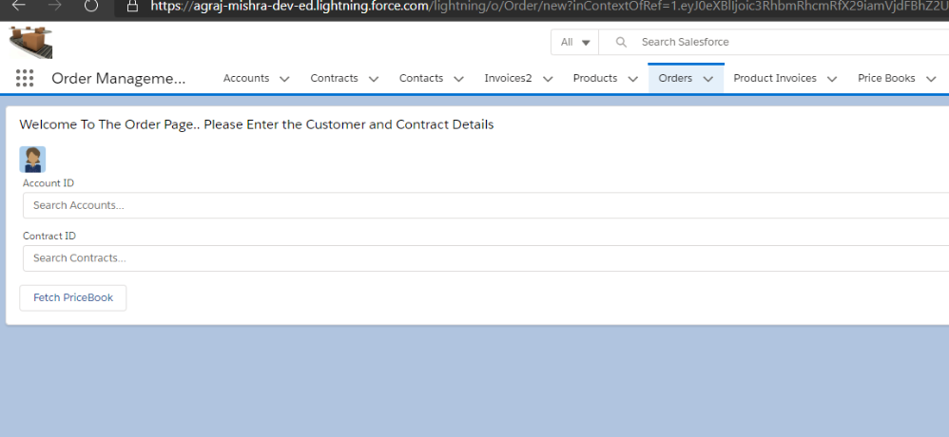
Some WalkThrough ScreenShots

Slide 17
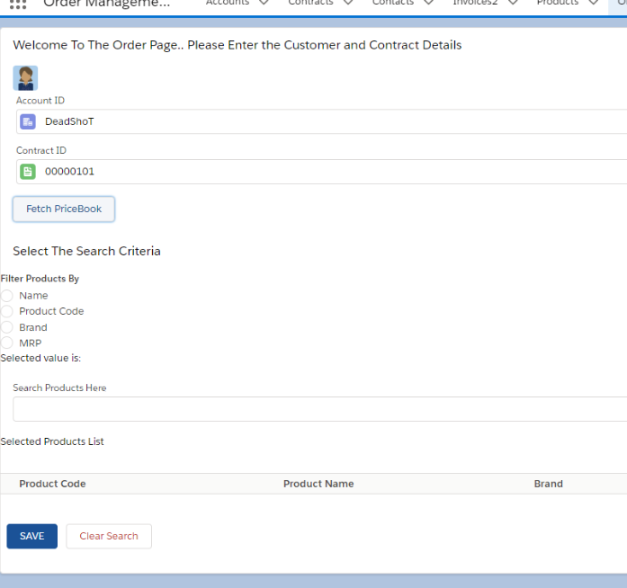

Slide 18
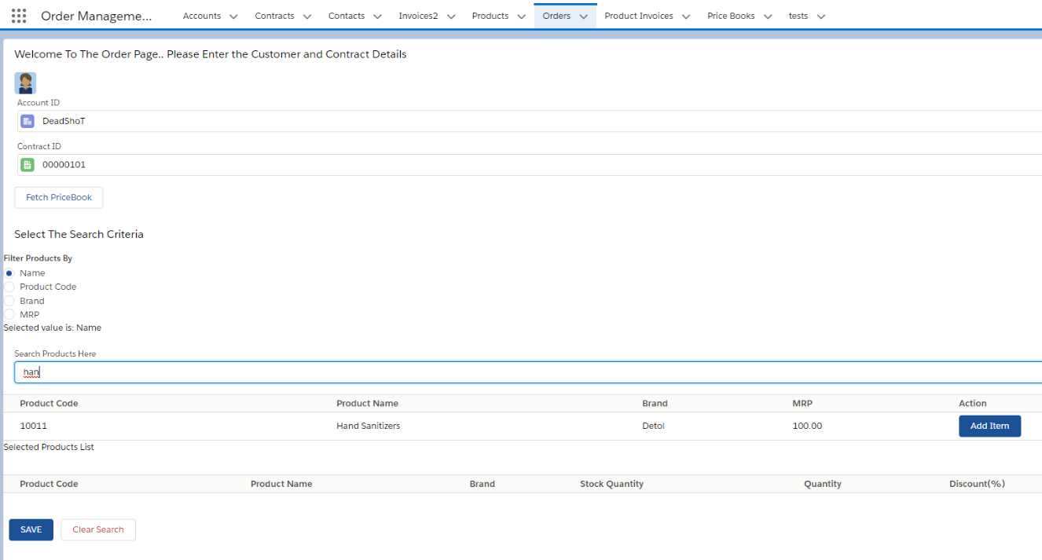

Slide 19
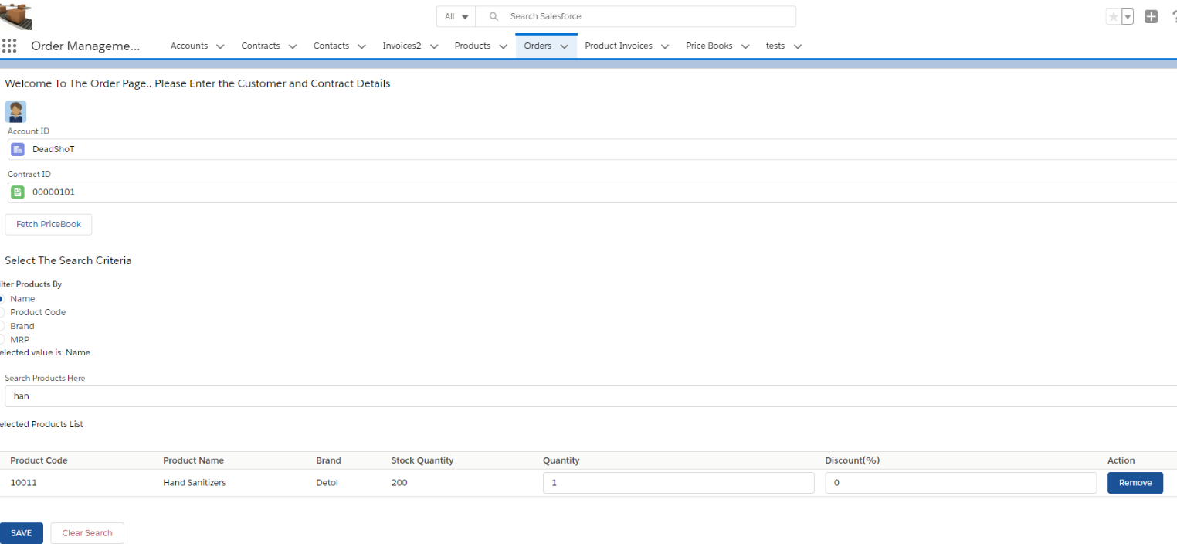

Slide 20
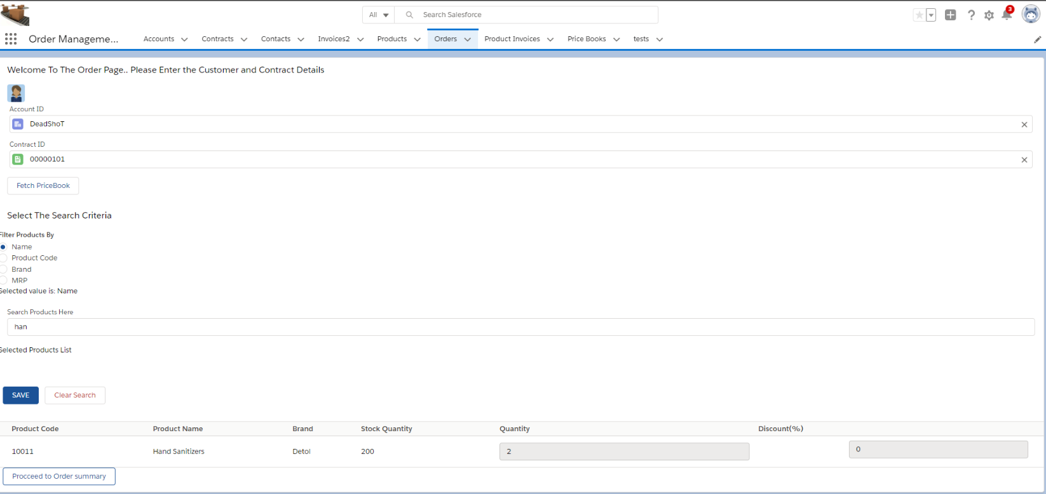

Slide 21
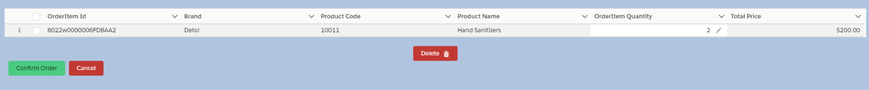
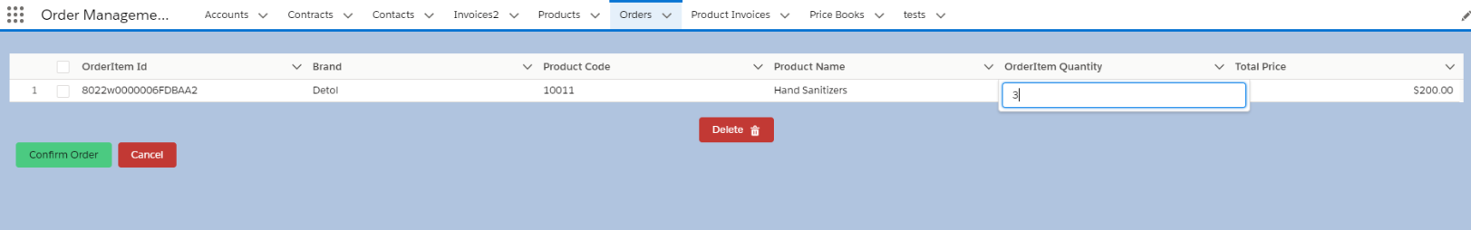
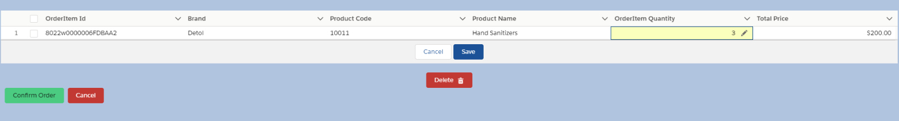
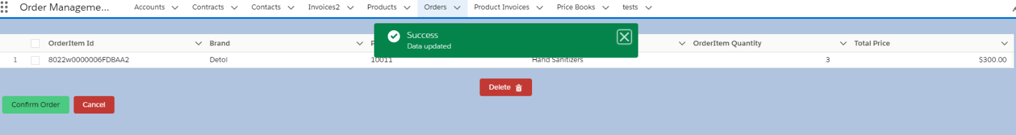

Slide 22
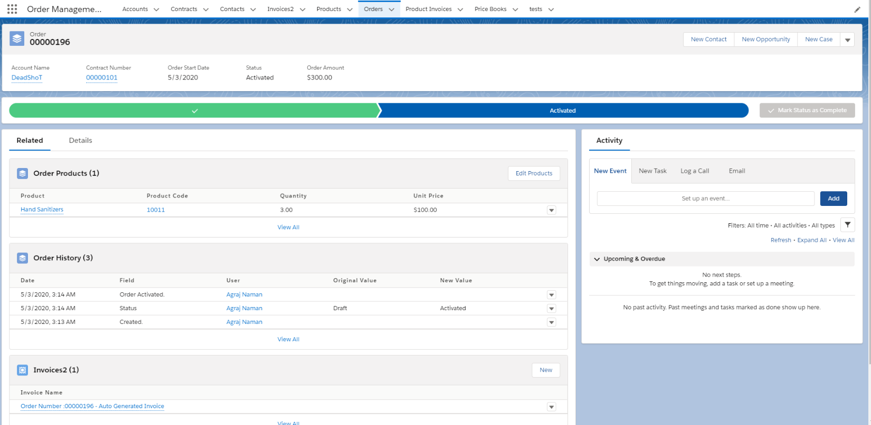

Slide 23
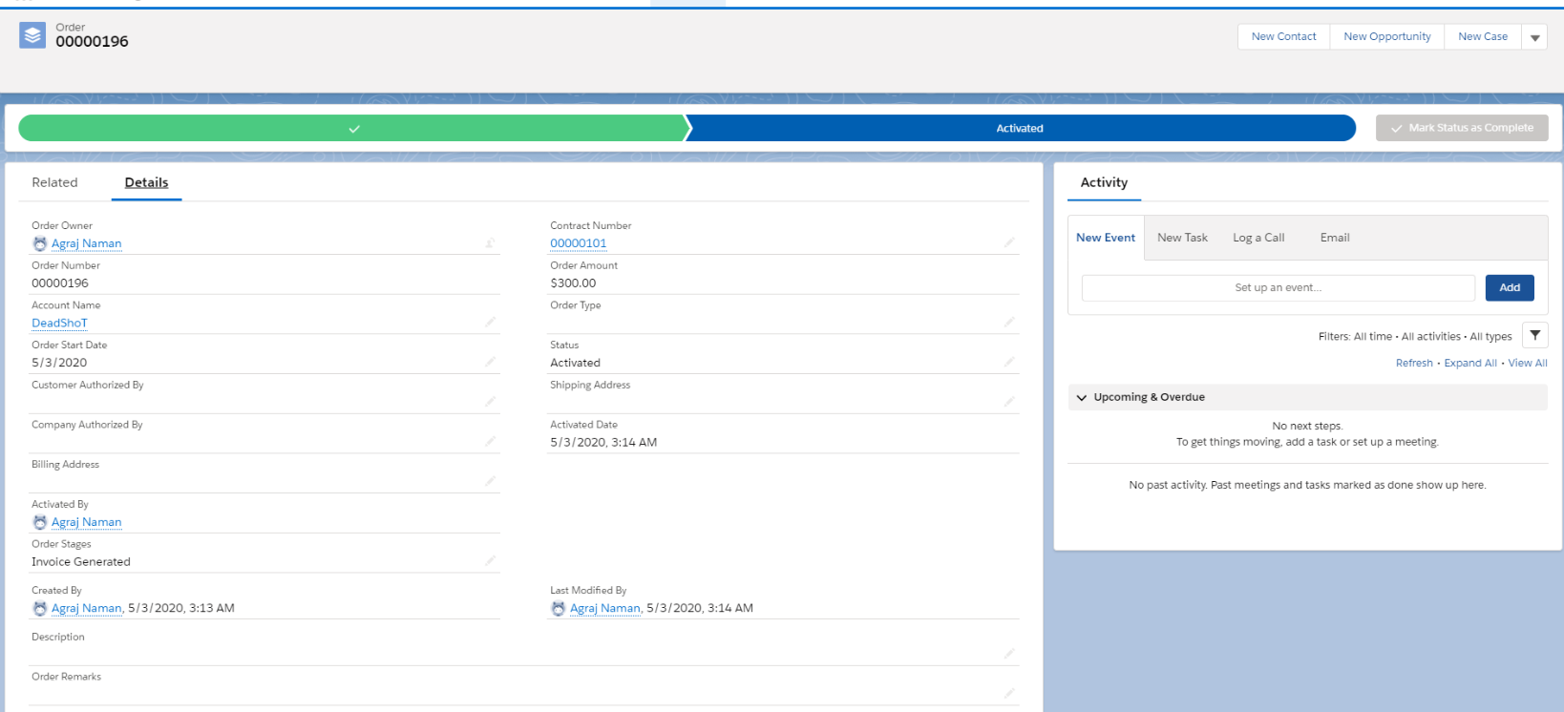

Slide 24
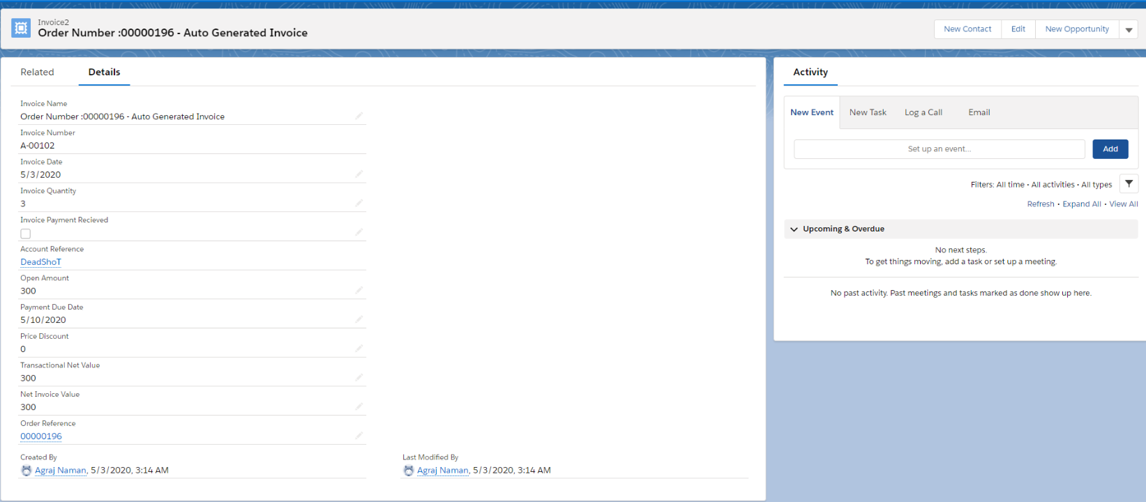

Slide 25
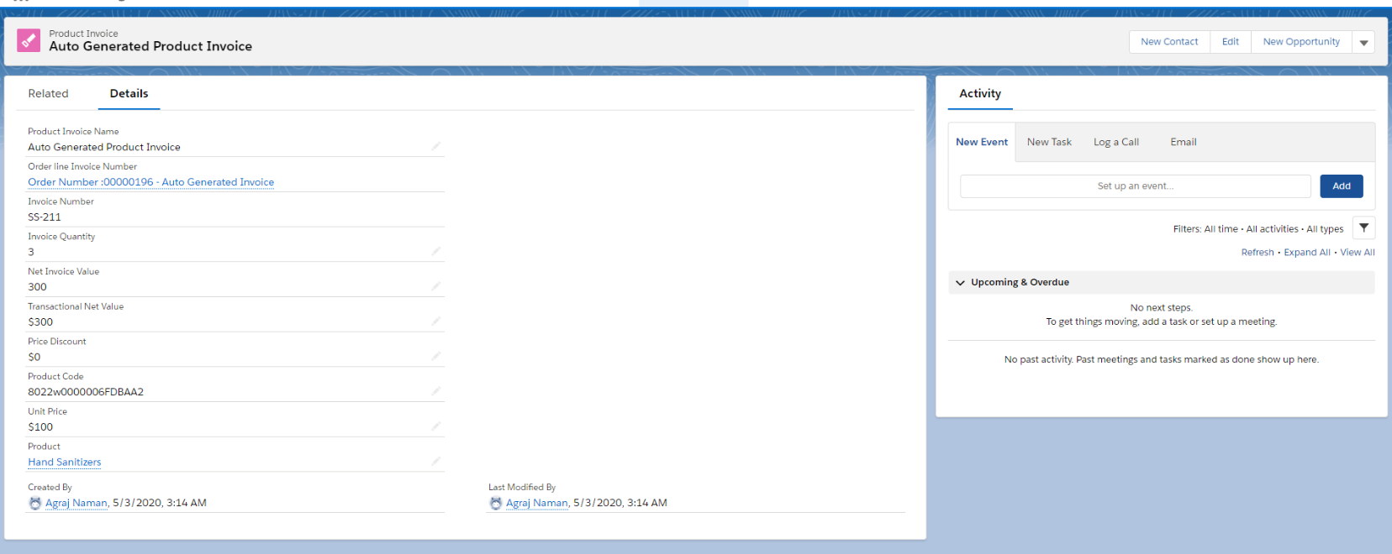

Slide 26
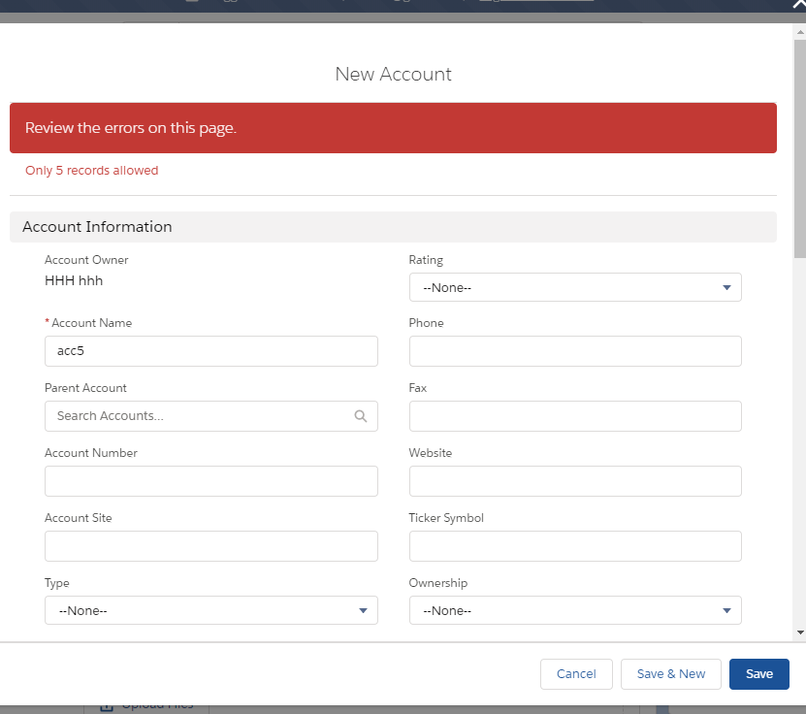
Some Validations :

Slide 27
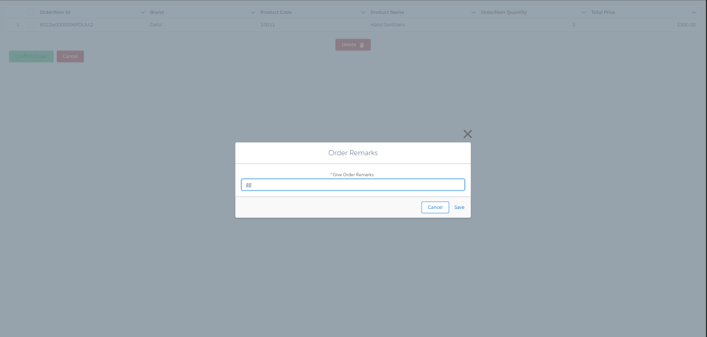

Slide 28
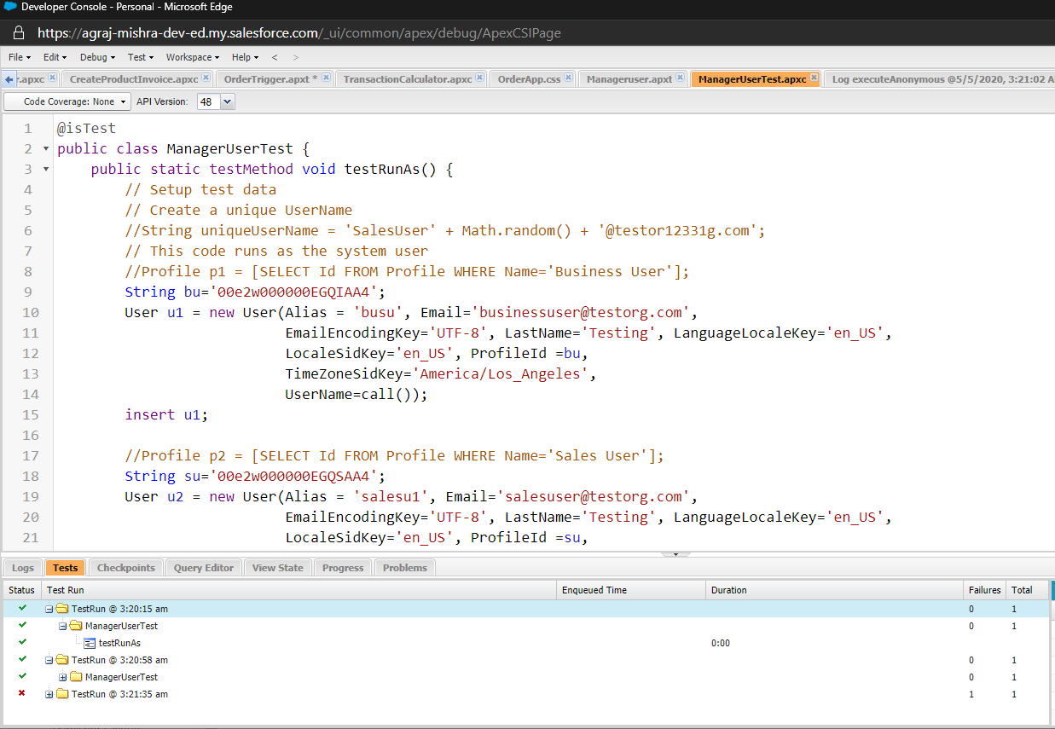

Slide 29
Validation
Support team can monitor entire records.
Each Business user can have 2 sales users under them and there will be no trespassing of the data.
Each Sales User is allowed to own 5 accounts beneath them.
Order stage is progressive only and is only changed programatically.
Product Stock and availability of product is validated wisely as per requirements.
Order above $100000 go under an aprroval process.

Slide 30
Assumptions
Only One currency is circulated through entire org.
Order stage flow would be :
Saved : When the order is getting saved using stage button ,but not yet confirmed.
Created : When the Order is confirmed using Confirm Order Button.
In Process : When the Order is getting approved.
Invoice Generated : When the Invoice gets generated.
Payment Received : When the Invoice Payment Received field is true.
Delivery in Plan : After Payment received stage and before the delivery of the Order.
Delivered : When the order gets delivered.
Cancelled : When the order is cancelled by the Sales User or not approved by the associated Business User.
Once an Order is placed and its Invoice is generated then there will be no alteration of data within that record.

Slide 31
Result and Summary
Assuming all those things mentioned in assumption. This Order Management System follows and fulfils all the use cases asked.
The making of this application required:
Sales force admin features :
Process builder
Approval Process
Reports and Dashboards.
Custom notification and email templates
Profile and Sharing Settings.
LWC
Apex triggers classes
Aura – {button overriding}

